Slide 1
Diyala university
College of engineering
Department of computer engineering
Second stage
8086 Microprocessor
Assistant lecturer: Abdullah Thaier Abdalsatir

Slide 2
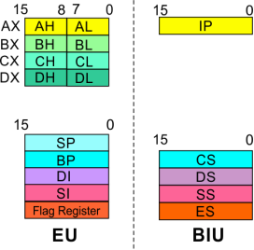
8086
Microprocessor
Architecture
Execution Unit (EU)
EU
Registers
Source Index (SI) and Destination Index (DI)
Used in indexed addressing.
Instructions that process data strings use the SI and DI
registers together with DS and ES respectively in order to
distinguish between the source and destination addresses.
31

Slide 3
8086
Microprocessor
Architecture
Execution Unit (EU)
EU
Registers
Source Index (SI) and Destination Index (DI)
Used in indexed addressing.
Instructions that process data strings use the SI and DI
registers together with DS and ES respectively in order to
distinguish between the source and destination addresses.
32

Slide 4
8086
Microprocessor
Architecture
Execution Unit (EU)
Auxiliary Carry Flag
Carry Flag
This is set, if there is a carry from the
lowest nibble, i.e, bit three during
addition, or borrow for the lowest
This flag is set, when there is
a carry out of MSB in case of
addition or a borrow in case of
subtraction.
Flag Register
nibble,
bit
three,
during
i.e,
subtraction.
Zero Flag
Parity Flag
Sign Flag
This flag is set, if the result of
the computation or comparison
performed by an instruction is
zero
This flag is set to 1, if the lower
byte of the result contains even
number of 1’s ; for odd number of
1’s set to zero.
This flag is set, when the
result of any
computation is negative
15
14
13
12
11
10
9
8
7
6
5
4
3
2
1
0
OF
DF
IF
TF
SF
ZF
AF
PF
CF
Over flow Flag
This flag is set, if an overflow occurs, i.e, if the result of a signed
operation is large enough to accommodate in a destination
register. The result is of more than 7-bits in size in case of 8-bit
signed operation and more than 15-bits in size in case of 16-bit
sign operations, then the overflow will be set.
Tarp Flag
If this flag is set, the processor
enters the single step execution
mode by generating internal
interrupts after the execution of
each instruction
Direction Flag
Interrupt Flag
Causes the 8086 to recognize
external mask interrupts; clearing IF
disables these interrupts.
This is used by string manipulation instructions. If this flag bit is ‘0’,
the string is processed beginning from the lowest address to the
highest address, i.e., auto incrementing mode. Otherwise, the string
is processed from the highest address towards the lowest address,
i.e., auto incrementing mode.
33

Slide 5
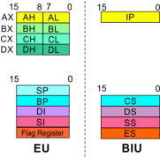
8086
Microprocessor
Architecture
8086 registers
categorized
into 4 groups
15 14 13 12
11
10
9
8
7
6
5
4
3
2
1
0
OF
DF
IF
TF
SF
ZF
AF
PF
CF
Sl.No.
Type
Register width
Name of register
1
General purpose register
16 bit
AX, BX, CX, DX
8 bit
AL, AH, BL, BH, CL, CH, DL, DH
2
Pointer register
16 bit
SP, BP
3
Index register
16 bit
SI, DI
4
Instruction Pointer
16 bit
IP
5
Segment register
16 bit
CS, DS, SS, ES
6
Flag (PSW)
16 bit
Flag register
34

Slide 6
8086
Microprocessor
Architecture
Registers and Special Functions
Register
Name of the Register
Special Function
AX
16-bit Accumulator
Stores the 16-bit results of arithmetic and logic
operations
AL
8-bit Accumulator
Stores the 8-bit results of arithmetic and logic
operations
BX
Base register
Used to hold base value in base addressing mode
to access memory data
CX
Count Register
Used to hold the count value in SHIFT, ROTATE
and LOOP instructions
DX
Data Register
Used to hold data for multiplication and division
operations
SP
Stack Pointer
Used to hold the offset address of top stack
memory
BP
Base Pointer
Used to hold the base value in base addressing
using SS register to access data from stack
memory
SI
Source Index
Used to hold index value of source operand (data)
for string instructions
DI
Data Index
Used to hold the index value of destination
operand (data) for string operations
35

Slide 7
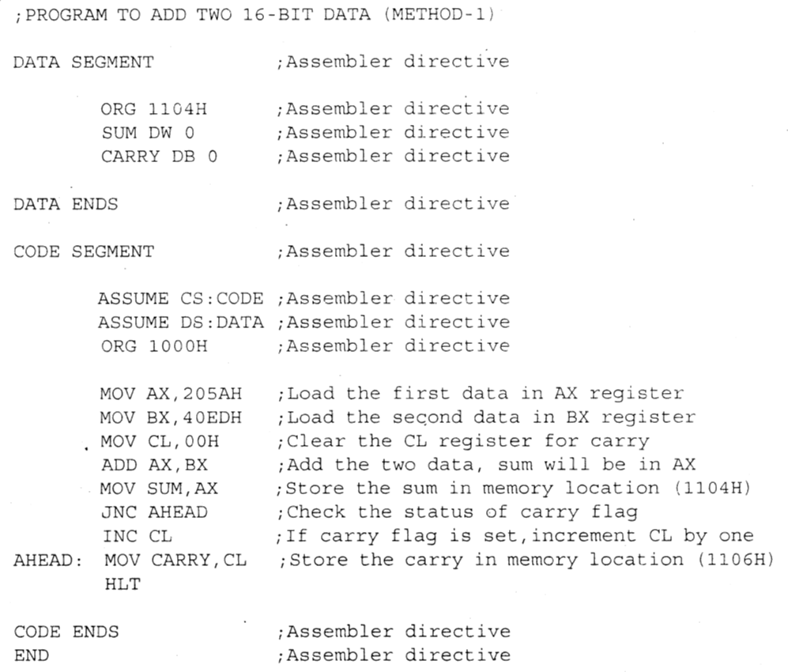
8086
Microprocessor
Introduction
Program
A set of instructions written to
solve a problem.
Instruction
Directions which a microprocessor
follows to execute a task or part of
a task.
Computer language
High Level
Low Level
Machine Language
Assembly Language
Binary bits
Eng
lish
Alphabets
■ ‘Mnemonics’
■ Assembler
Mnemonics  Machine
Language
36

Slide 8
8086
Microprocessor
Introduction
Program
to solve a problem.
Instructions are the directions which a microprocessor follows to execute a
task or part of a task. Broadly, computer language can be divided into
two parts as high-level language and low level language. Low level language
are machine specific. Low level language can be further divided into machine
language and assembly language.
is a set of instructions
written
Machine language is the only language which a machine can understand.
Instructions in this language are written in binary bits as a specific bit pattern.
The computer interprets this bit pattern as an instruction to perform a
particular task. The entire program is a sequence of binary numbers. This is
a machine-friendly language but not user friendly. Debugging is another
problem associated with machine language.
To overcome these problems, programmers develop another way in which
instructions are written in English alphabets. This new language is known as
termed
mnemonics. As microprocessor can only understand the machine language
so mnemonics are translated into machine language either manually or by
a program known as
Assembly
language.
The
instructions
in
this
language
are
assembler.
37

Slide 9
8086
Microprocessor
Addressing Modes
Every instruction of a program has to operate on a data.
The different ways in which a source operand is denoted in
an instruction are known as addressing modes.
1. Register Addressing
Group I: Addressing modes for
register and immediate data
2. Immediate Addressing
3. Direct Addressing
4. Register Indirect Addressing
5. Based Addressing
Group II: Addressing modes for
6. Indexed Addressing
memory data
7. Based Index Addressing
8. String Addressing
9. Direct I/O port Addressing
Group III: Addressing modes for
10. Indirect I/O port Addressing
I/O ports
11. Relative Addressing
Group IV: Relative Addressing mode
12. Implied Addressing
Group V: Implied Addressing mo
38de

Slide 10
8086
Microprocessor
Addressing Modes
Group I : Addressing modes for
register and immediate data
The
instruction
will
specify
the
name
of
1. Register Addressing
the
register which holds the data to be operated by
the instruction.
2.
Immediate Addressing
3. Direct Addressing
Example:
4. Register Indirect Addressing
MOV CL, DH
5. Based Addressing
The content of 8-bit register DH is moved to
another 8-bit register CL
6. Indexed Addressing
7. Based Index Addressing
(CL)  (DH)
8. String Addressing
9.
Direct I/O port Addressing
10. Indirect I/O port Addressing
11. Relative Addressing
12. Implied Addressing
39

Slide 11
8086
Microprocessor
Addressing Modes
Group I : Addressing modes for
register and immediate data
1. Register Addressing
2. Immediate Addressing
In immediate addressing mode, an 8-bit or 16-bit
data is specified as part of the instruction
3. Direct Addressing
Example:
4. Register Indirect Addressing
MOV DL, 08H
5. Based Addressing
The 8-bit data (08H) given in the instruction is
moved to DL
6. Indexed Addressing
7. Based Index Addressing
(DL)  08H
8. String Addressing
MOV AX, 0A9FH
9.
Direct I/O port Addressing
10. Indirect I/O port Addressing
The 16-bit data (0A9FH) given in the instruction is
moved to AX register
11. Relative Addressing
(AX)  0A9FH
12. Implied Addressing
40

